Slide 1

PIMS
P.O. Information
Management System
Interocean Trade & Transportation, Inc.
900 SW 16th St, Ste 330
Renton, WA 98057
800-321-9481
itti@ittiusa.com

Slide 2

Integrated Supply Chain Management
Start to finish, know the status of your supply chain at all times
Delivery
Shipper
Carrier
Warehouse

Slide 3
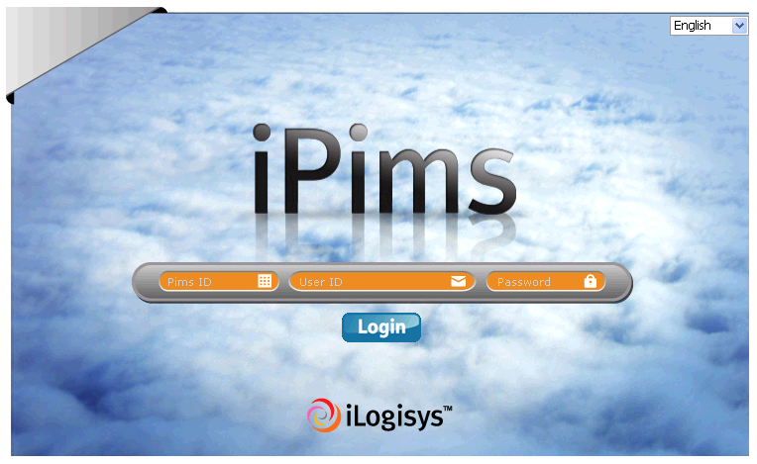
PIMS
P.O. Information Management System

Slide 4
What is PIMS?
PIMS is a Purchase Order Information Management System which enables you to manage your shipment information and cargo status.
PIMS can easily be accessed via the internet by all related parties.
  Protected by PIMS ID, username & password.

Slide 5
Integrated Supply Chain Management
Carrier
Overseas
Agent
You
PIMS
Shipper
ITTI
U.S. Customs

Slide 6

What is the Benefit of PIMS?
Information sharing by an unlimited number of users featuring:
  Planned/Estimated/Actual Milestones
  Pre-Alert & Exception Notification
  AMS/ISF Filing
  Real-time Cargo Tracking

Slide 7
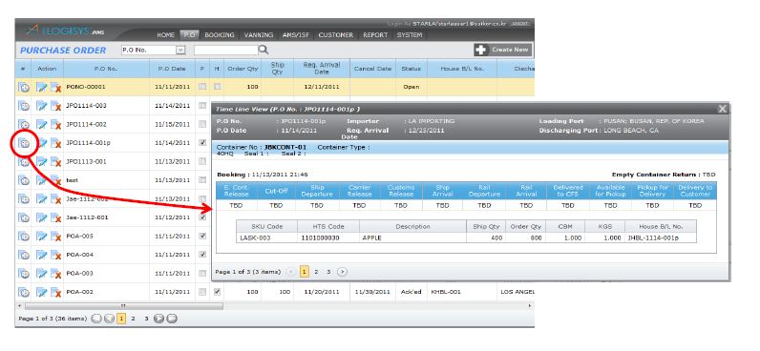
Start with your Purchase Order
Detailed information regarding your P.O.
  SKU
  Desired arrival and decision cutoff dates
  HTS Code
  Quantity, etc.

Slide 8
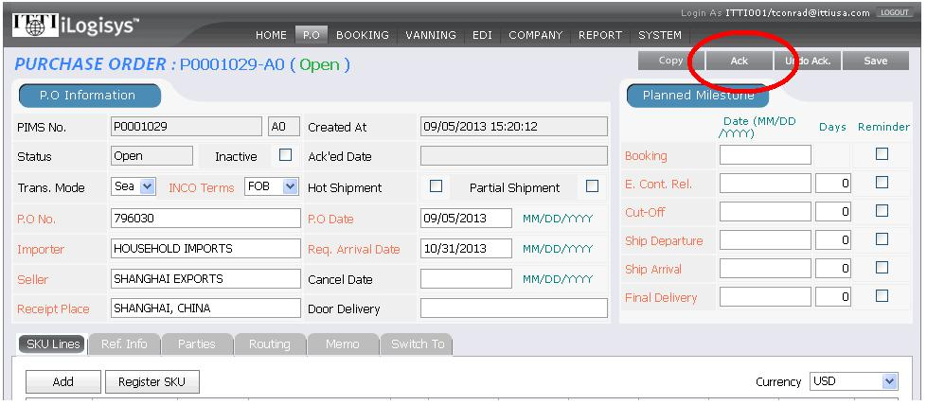
The Purchase Order is acknowledged by your shipper
Confirming they understand your shipping requirements

Slide 9
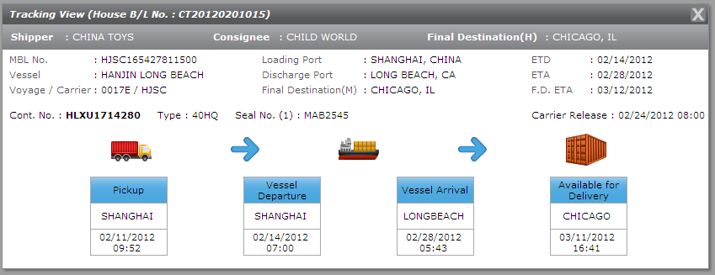
Booking
ITTI’s Overseas Agent will create a booking with the carrier and attach your P.O.
From the moment your booking is made you can track your shipment

Slide 10
Tracing
You may obtain your shipment information via
  P.O. Number
  Booking Number
  Container Number
  MBL & HBL Numbers
  Loading & Discharge Ports
  Final Destination

Slide 11
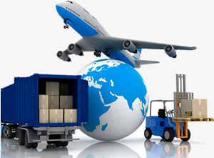
Carrier EDI
Booking
Ship Departure
Ship Arrival
Carrier Release
Rail Departed
Pickup Availability
Pickup for Delivery
Warehouse Delivery

Slide 12
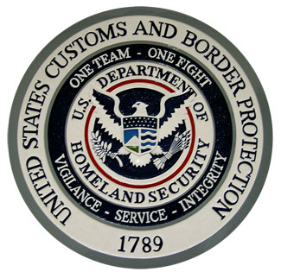
U.S. Customs EDI
Customs Release Status
CET Exam Hold
USDA Hold
OGA Hold
NII Exam Hold

Slide 13
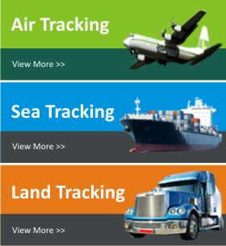
Multiple Modes of Transit Supported by PIMS
Inbound
Outbound
Both ocean and air

Slide 14
The Value of PIMS
A value-added service enabling you to take control of your supply chain
  Proactive management of your supply chain - Use information to drive planning and forecasting activities.
  Know the specific metrics required of each milestone in your supply chain.

Slide 15
The Value of PIMS
A value-added service enabling you to take control of your supply chain
  Increased potential to reduce warehousing expenses and in turn improving outbound fulfillment planning.
  Allow company resources to focus on core activities- Increasing efficiency and reducing waste.
  Increase your competitive advantage.

Slide 16

Thank you!
Interocean Trade & Transportation, Inc.
900 SW 16th St, Ste 330
Renton, WA 98057
800-321-9481
itti@ittiusa.com

